Slide 1
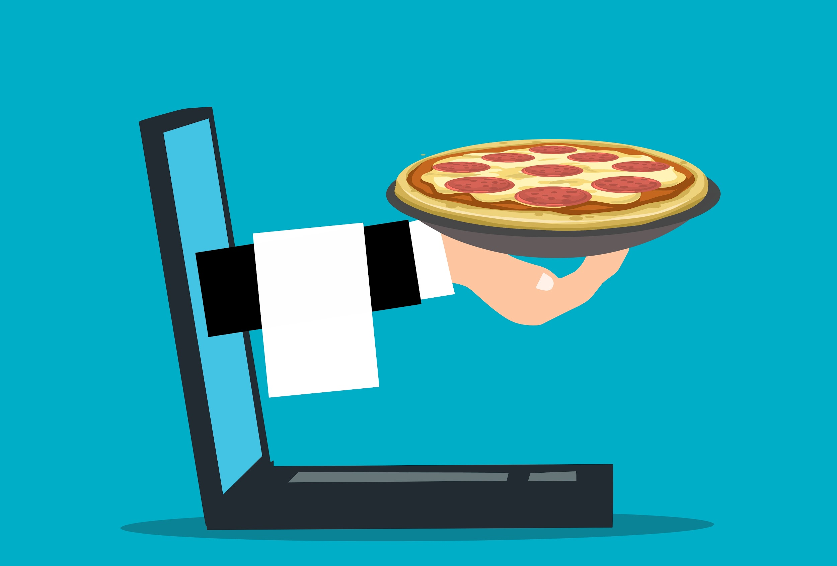
RICETTA- Food Recipe Application
App Name: Ricetta
Team Number: Team 11
Team Name: Ricetta
Team Members: Tanmay Kakade(1002023412)
Mrunmai Magar(1002092125)
Neha More(1002060504)
Utkarsh Sonawane(1002029320)
Aditya Vichare (1001968015)
Date: 04/03/2023
Iteration #02
CSE 5324-001 Software Engineering: Analysis, Design, and Testing

Slide 2
Agenda
Project Description
Overall Design Approach
Requirements
Use Cases
Domain Diagram
RUCTM
Increment Matrix
EUC/ UIPs
Sequence Diagram
Design Class Diagram
Code Snaps
Summary

Slide 3
Project Description
We aim on developing Ricetta- a Food Recipe application, which aids its users in discovering new recipes to satisfy their hunger pangs.
Our application helps users find and view different food recipes based on different categories, as well as allowing them to add their own recipes to the database.
This is very handy application, which every user can search for recipes, save recipe as favorite, and create personal cookbook for daily or weekly meals.
The app aspires to run efficiently, while having an intuitive a simple design that provides the user all the necessary functionalities.
The project will be implemented using Java programming , Android and SQLite/MySQL.

Slide 4
Overall Design Approach
Generation of Idea
Planning & Analysis
Writing features for the app
Creating detailed app specifications
Testing
Development & Coding
Designing features

Slide 5
Requirements
ReqID | Requirement Statement
R1 | The system shall provide authenticated login for users to access Ricetta app
R2 | The system shall provide a selection pane to separate recipes into categories.
R3 | The system shall suggest recipes of similar kind based on the choice user has chosen.
R4 | The system shall allow users to learn the nutritional values of a chosen recipe.
R5 | The system shall provide a list of ingredients based on the recipe selected.
R6 | The system shall provide user to check for how much preparation time and cooking time is required.
R7 | The system shall provide how many people can have the dish.
R8 | The system shall provide a complete description and instructions about how the dish should be prepared, cooked, and served.
R9 | The system shall provide a feature where users can rate/ comment on a recipe, and to view previous feedbacks..
R10 | The system shall provide the flexibility to add favourite recipes into their favourite list.
R11 | The system shall provide users the flexibility to create a daily or weekly meal based on their preferences.

Slide 6
Use Cases
Use Case # | Use Case Name
UC1 | User Registeration/ Login
UC2 | Display Categories
UC3 | Recipe List
UC3.1 | Recipe Information
UC3.2 | Nutritional Values
UC3.3 | Write Feedback
UC3.4 | Provide Review
UC3.5 | Number of Servings
UC3.6 | Add recipe to favourites
UC4 | Suggest Similar Recipes
UC5 | Create Daily/ Weekly Menu

Slide 7
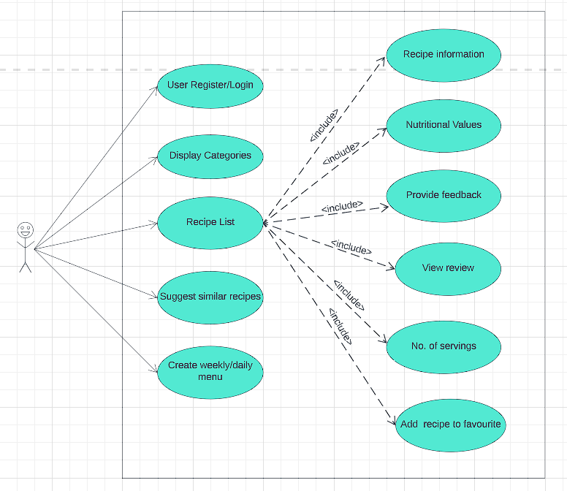
Use Case Diagram

Slide 8
High level Use Cases
UC1: User Registration/ Login
-TUCBW the user enters his credentials, and clicks on login button
-TUCEW the user gets logged in and the home screen is displayed.
UC2: Display Categories
-TUCBW the user clicks on display categories button.
-TUCEW the user viewing all the various categories available
UC3: Recipe List
-TUCBW the user selecting the category
-TUCEW the user viewing all the recipes belonging to the desired category
UC3.1: Recipe Information
-TUCBW the user clicking on the View button
-TUCEW the user acknowledging the list of ingredients and the cooking time of the selected recipe
UC3.2: Nutritional Values
-TUCBW the user clicking the nutrition info button
-TUCEW the user viewing the nutritional value chart.
UC3.3: Provide Feedback
-TUCBW the user clicking on the provide feedback button.
-TUCEW the user successfully submitting the feedback.

Slide 9
High level Use Cases
UC 3.4: View Review
-TUCBW the user clicking on the view review button.
-TUCEW the user successfully viewing all the available reviews.
UC3.5: Number of Servings
-TUCBW the user scrolls down after choosing a recipe to ‘number of servings’ section.
-TUCEW this section displays how many people can enjoy the dish after they follow given recipe.
UC3.6: Add recipe to Favourites
-TUCBW the user sees an option along with the recipe to bookmark it for subsequent use
-TUCEW after clicking on ‘add to favourites’ the user adds the recipe to a list which later can be referred in future, if needed.
UC4: Suggest Similar Recipes
-TUCBW the user scrolls down after choosing a recipe to ‘Similar to this’ section.
-TUCEW recipes which are of similar kind are displayed to get a variety of similar choice
UC5: Create Weekly/ Daily Menu
-TUCBW user has an option to create a daily or weekly menu.
-TUCEW the user now has the flexibility to see a daily or weekly meal based on their preferences.

Slide 10
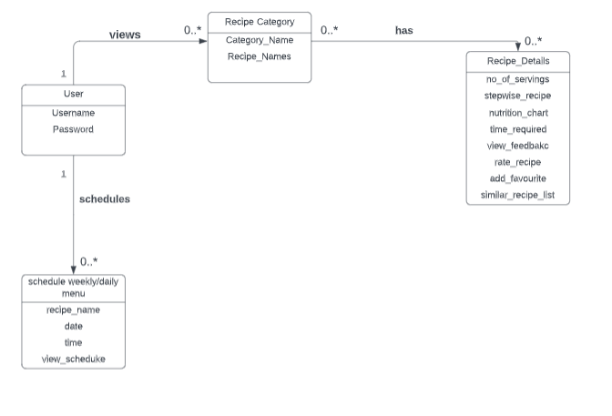
Domain Diagram

Slide 11
Requirements to Use Case Traceability Matrix
 | Priority Weight | UC1 | UC2 | UC3 | UC3.1 | UC3.2 | UC3.3 | UC3.4 | UC3.5 | UC3.6 | UC4 | UC5
R1 | 1 | X
R2 | 1 |  | X
R3 | 4 |  |  |  |  |  |  |  |  | X
R4 | 2 |  |  |  |  |  | X
R5 | 2 |  |  |  | X
R6 | 2 |  |  |  |  | X
R7 | 2 |  |  |  |  |  |  |  | X
R8 | 1 |  |  | X
R9 | 3 |  |  |  |  |  |  | X
R10 | 3 |  |  |  |  |  |  |  |  |  | X
R11 | 4 |  |  |  |  |  |  |  |  |  |  | X
 | SCORE | 1 | 1 | 1 | 2 | 2 | 2 | 3 | 2 | 3 | 3 | 4

Slide 12
Increment Matrix
Use Case | Priority | Effort(person-weeks) | Depends on | Assigned to | Iteration 1 (Due:02/27/23 ) | Iteration 2 (Due:04/03/23) | Iteration 3 (Due:04/19/23 )
UC1 | 1 | 2 | None | TK, AV | 2
UC2 | 1 | 3 | UC1 | US | 2 | 1
UC3 | 1 | 2 | UC2 | NM |  | 2
UC3.1 | 2 | 1 | UC2,UC3 | MM
UC3.2 | 2 | 1 | UC2,UC3 | MM |  | 1
UC3.3 | 2 | 1 | UC2,UC3 | NM |  | 1
UC3.4 | 3 | 2 | UC2,UC3 | US,NM
UC3.5 | 2 | 1 | UC2,UC3 | TK
UC3.6 | 3 | 2 | UC2,UC3 | AV
UC4 | 3 | 3 | UC2 | TK,MM
UC5 | 4 | 4 | UC1 | AV,NM
Total effort |  | 22 |  |  | 4 | 5
1 Person-Week = 5 hrs
Team Members: Tanmay K, Mrunmai M, Neha M, Utkarsh S, Aditya V

Slide 13
EUC/ UIPs
UC 2: Display categories
Pre-Condition: User has successfully logged in and is on the home screen
Actor: User | System: Ricetta App
 | 0. System authenticates the user and directs to the home page of the app
1. TUCBW the user clicks on display categories button. | 2. System provides a selection pane to separate recipes into categories
3. TUCEW the user viewing all the various categories available
Post Condition: The user should be able to select the desired category

Slide 14
EUC/ UIPs cont
UC 3: Recipe List
Pre-Condition: User can see the various categories
Actor: User | System: Ricetta App
 | 0. System displays the categories to the user
1. TUCBW the user selecting the category | 2. The system displays the recipes in the selected category
3. TUCEW the user viewing all the recipes belonging to the desired category
Post Condition: the user should successfully view the recipe list

Slide 15
EUC/ UIPs cont
UC 3.2: Recipe Information
Pre-Condition: The user has accessed the recipe list
Actor: User | System: Ricetta App
 | 0. The system lists all the available recipes of a particular category
1. TUCBW the user clicking on the View button | 2. The system displays the recipe information
3. TUCEW the user acknowledging the list of ingredients and the cooking time of the selected recipe
Post Condition: The user should be able to view the information of the selected recipe

Slide 16
EUC/ UIPs cont
UC 3.3: Nutritional Values
Pre Condition: the user has accessed the recipe list
Actor: User | System: Ricetta App
 | 0. The system lists all the available recipes of a particular category
1. TUCBW the user clicking the nutrition info button | 2. The system displays the nutrition values of the selected recipe
3. TUCEW the user viewing the nutrition value chart
Post Condition: The user should see the nutritional values of the selected recipe

Slide 17
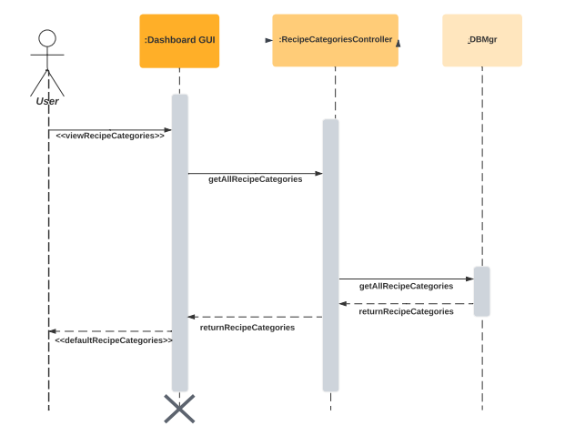
Sequence Diagram: Display Categories

Slide 18
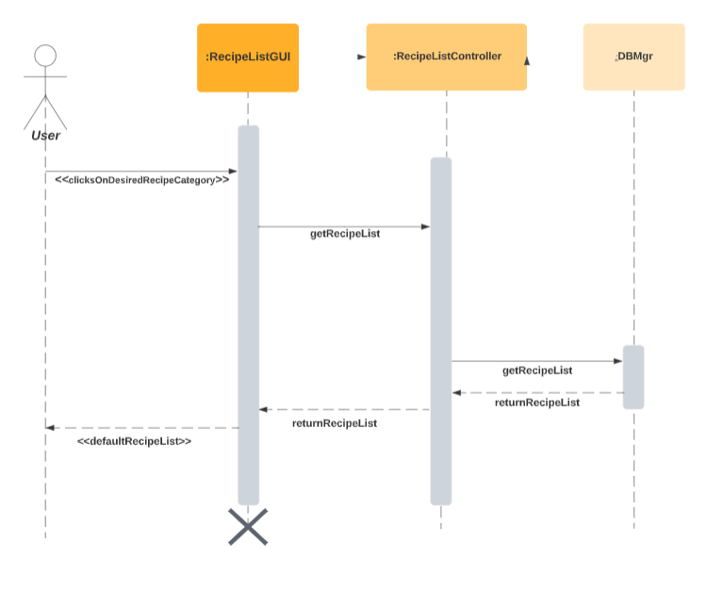
Sequence Diagram: Recipe List

Slide 19
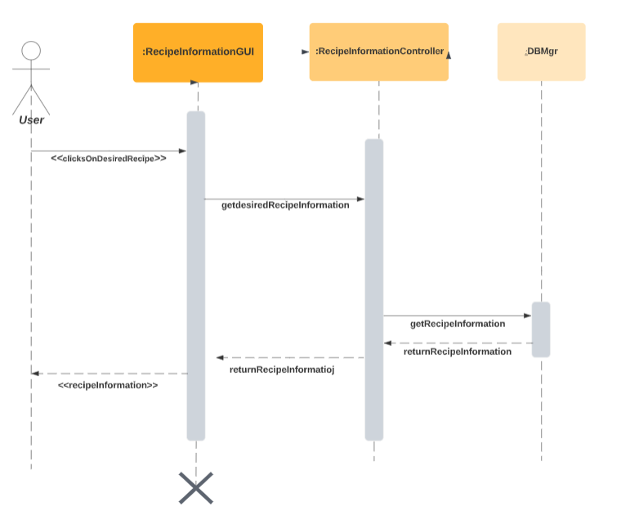
Sequence Diagram: Recipe Information

Slide 20
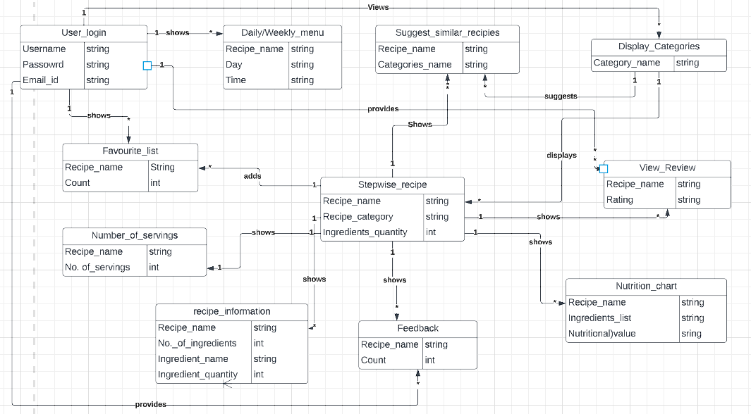
Design Class Diagram

Slide 21
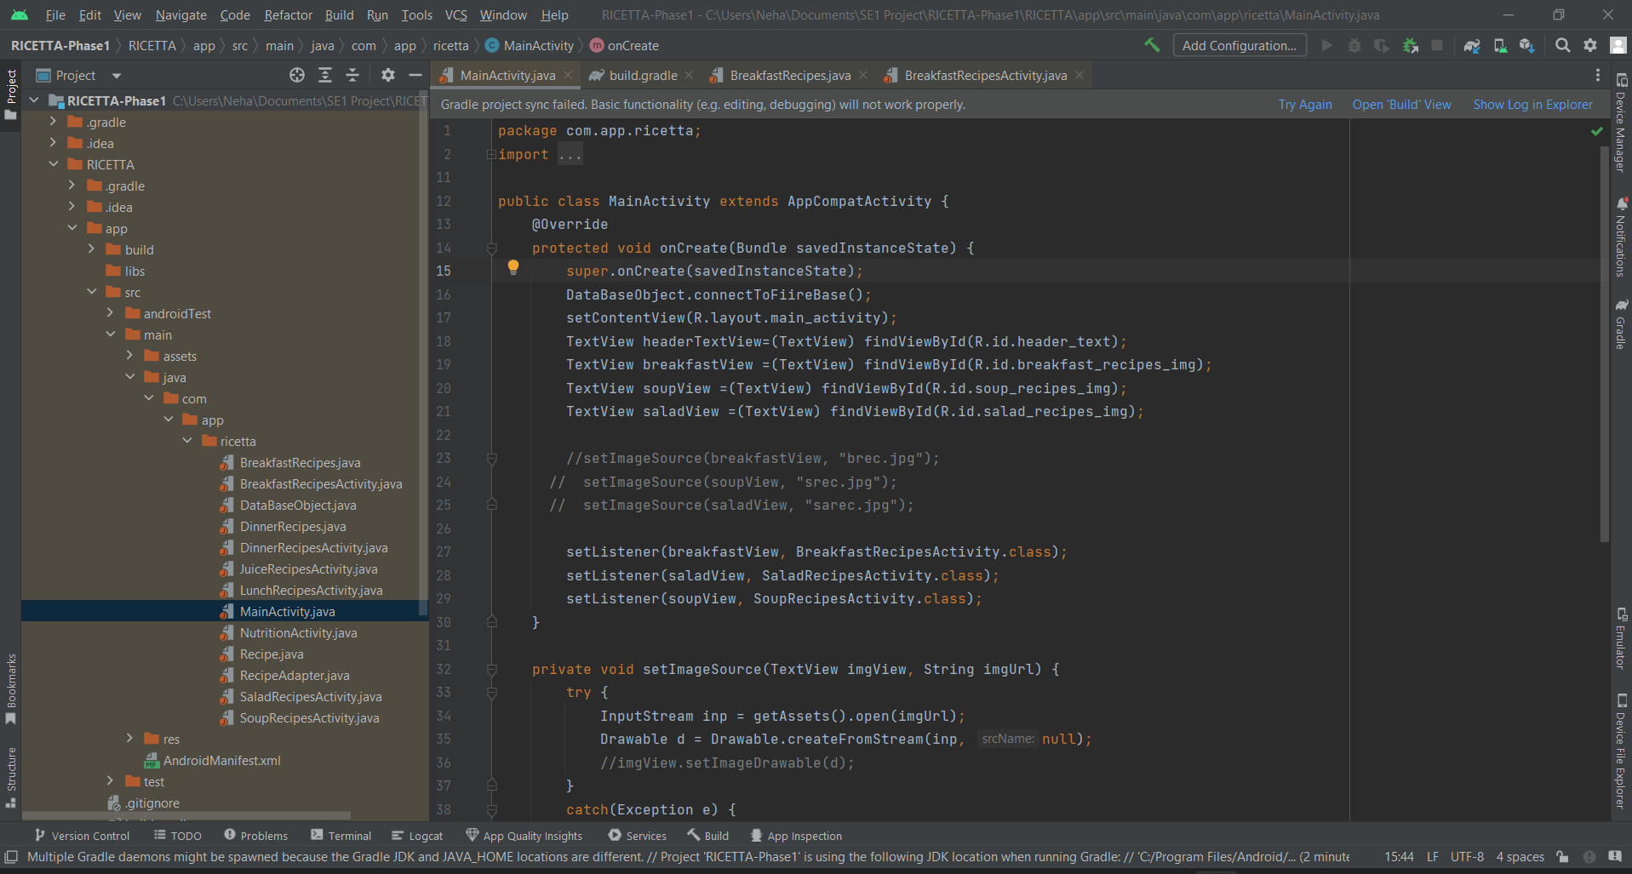
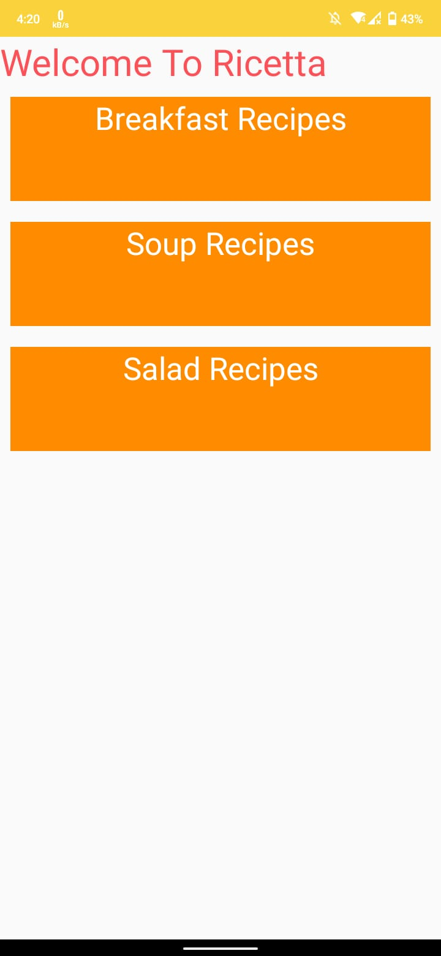
Code Snapshots: Display Categories

Slide 22
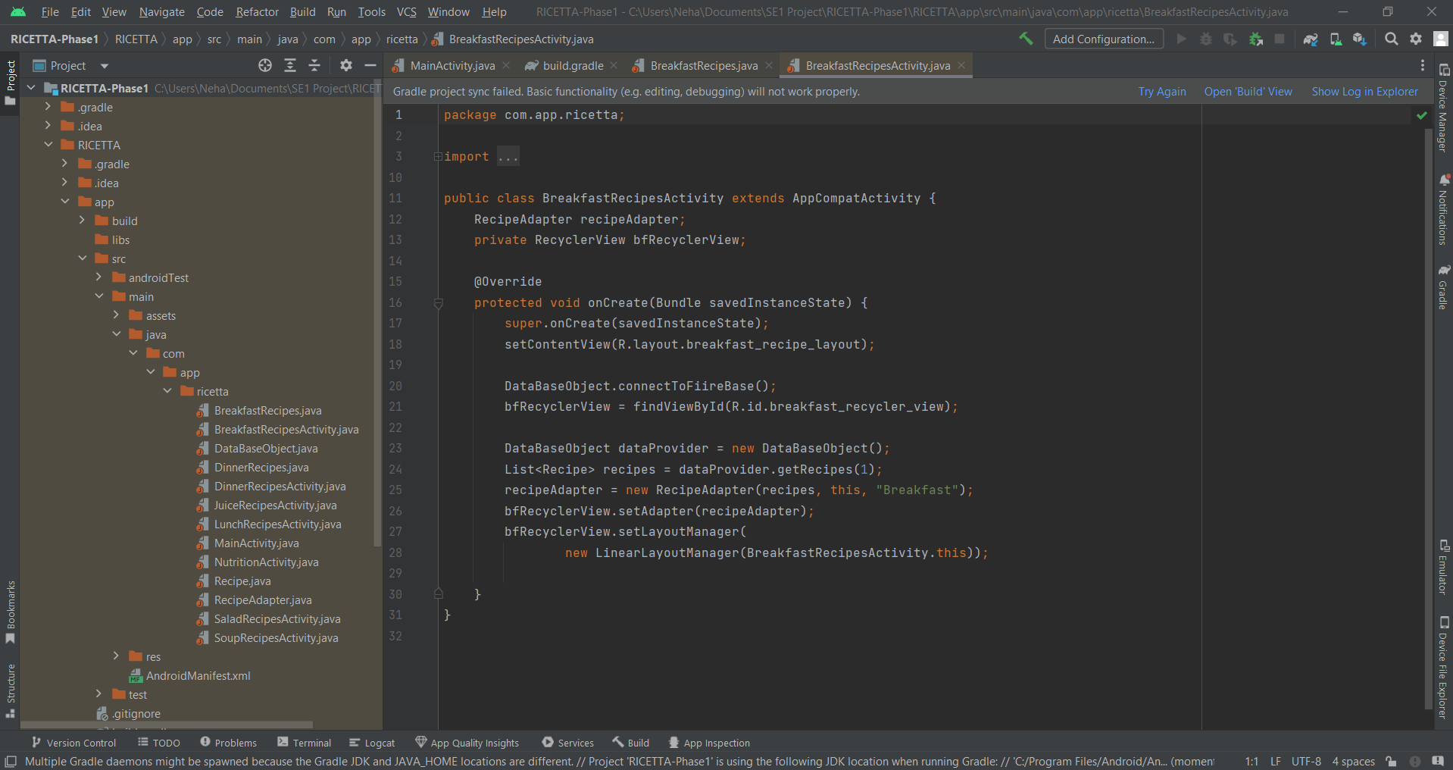
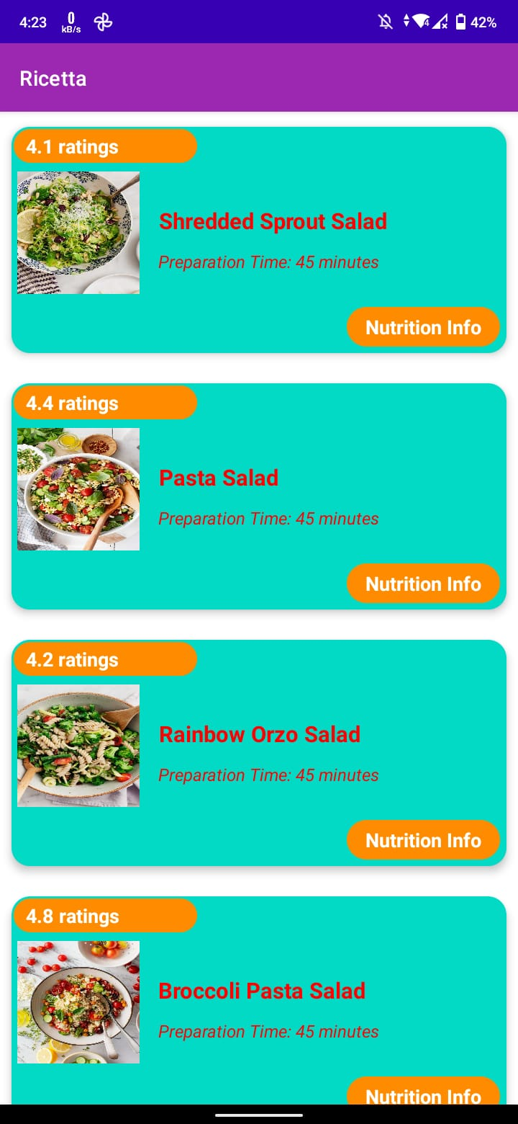
Code Snapshots: Recipe List

Slide 23
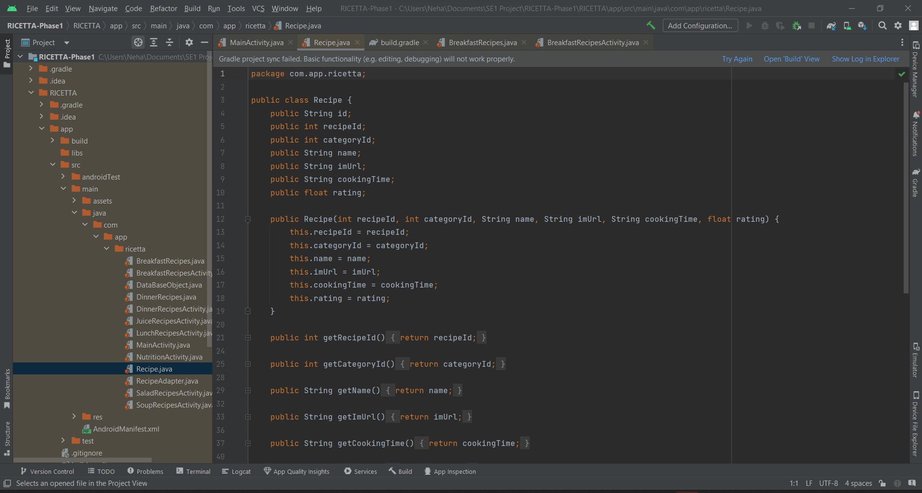
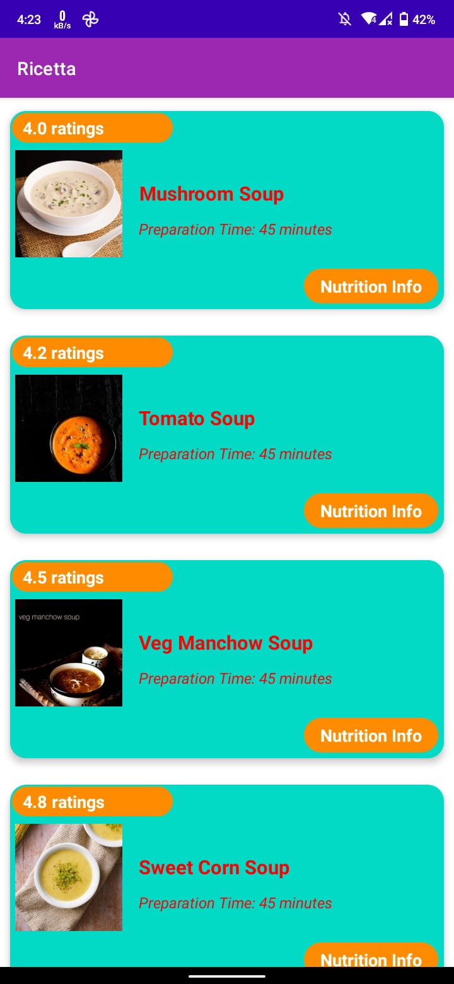
Code Snapshots: Recipe Information

Slide 24
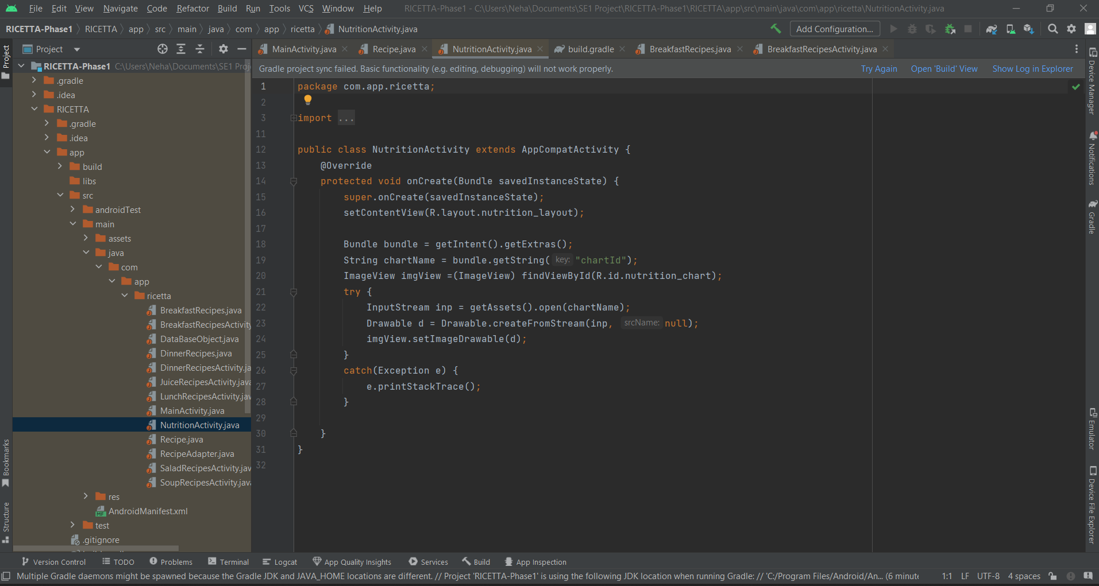
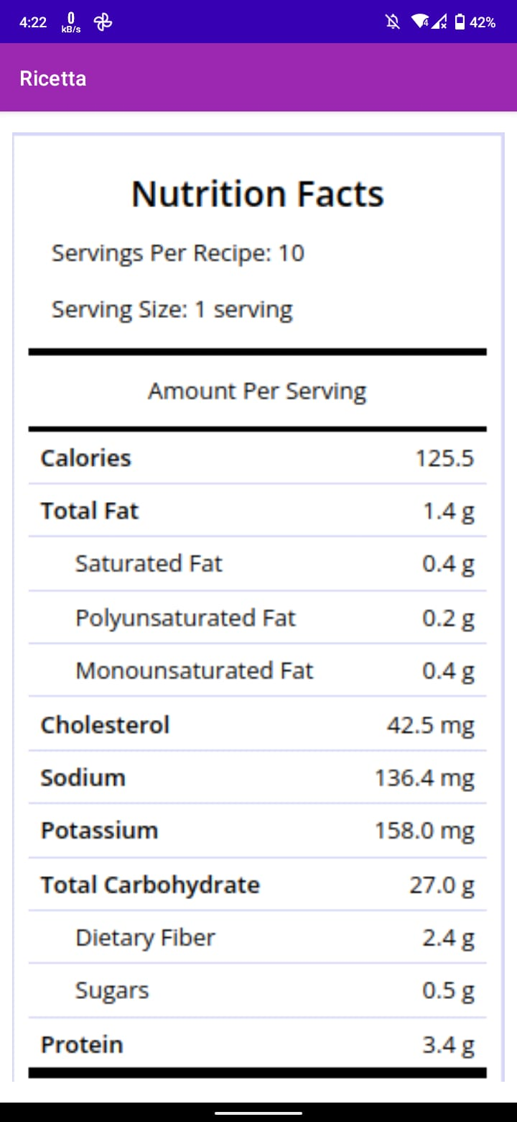
Code Snapshots: Nutrition Value

Slide 25
Summary
This application is extremely convenient and useful for a diverse variety of meals.
It will save time and energy when searching for everyday recipes as well as recipes for special occasions.
Since this is a mobile application, users can look for recipes whenever and wherever they are and also save them for later use.
The application can be used by a broad spectrum of people, which would include parents trying to cook new recipes for their children, dessert lovers, restaurant owners wanting to expand their menu, and regular cooks.

Slide 26
THANK YOU!

Slide 27
Any Questions?

